Slide 1
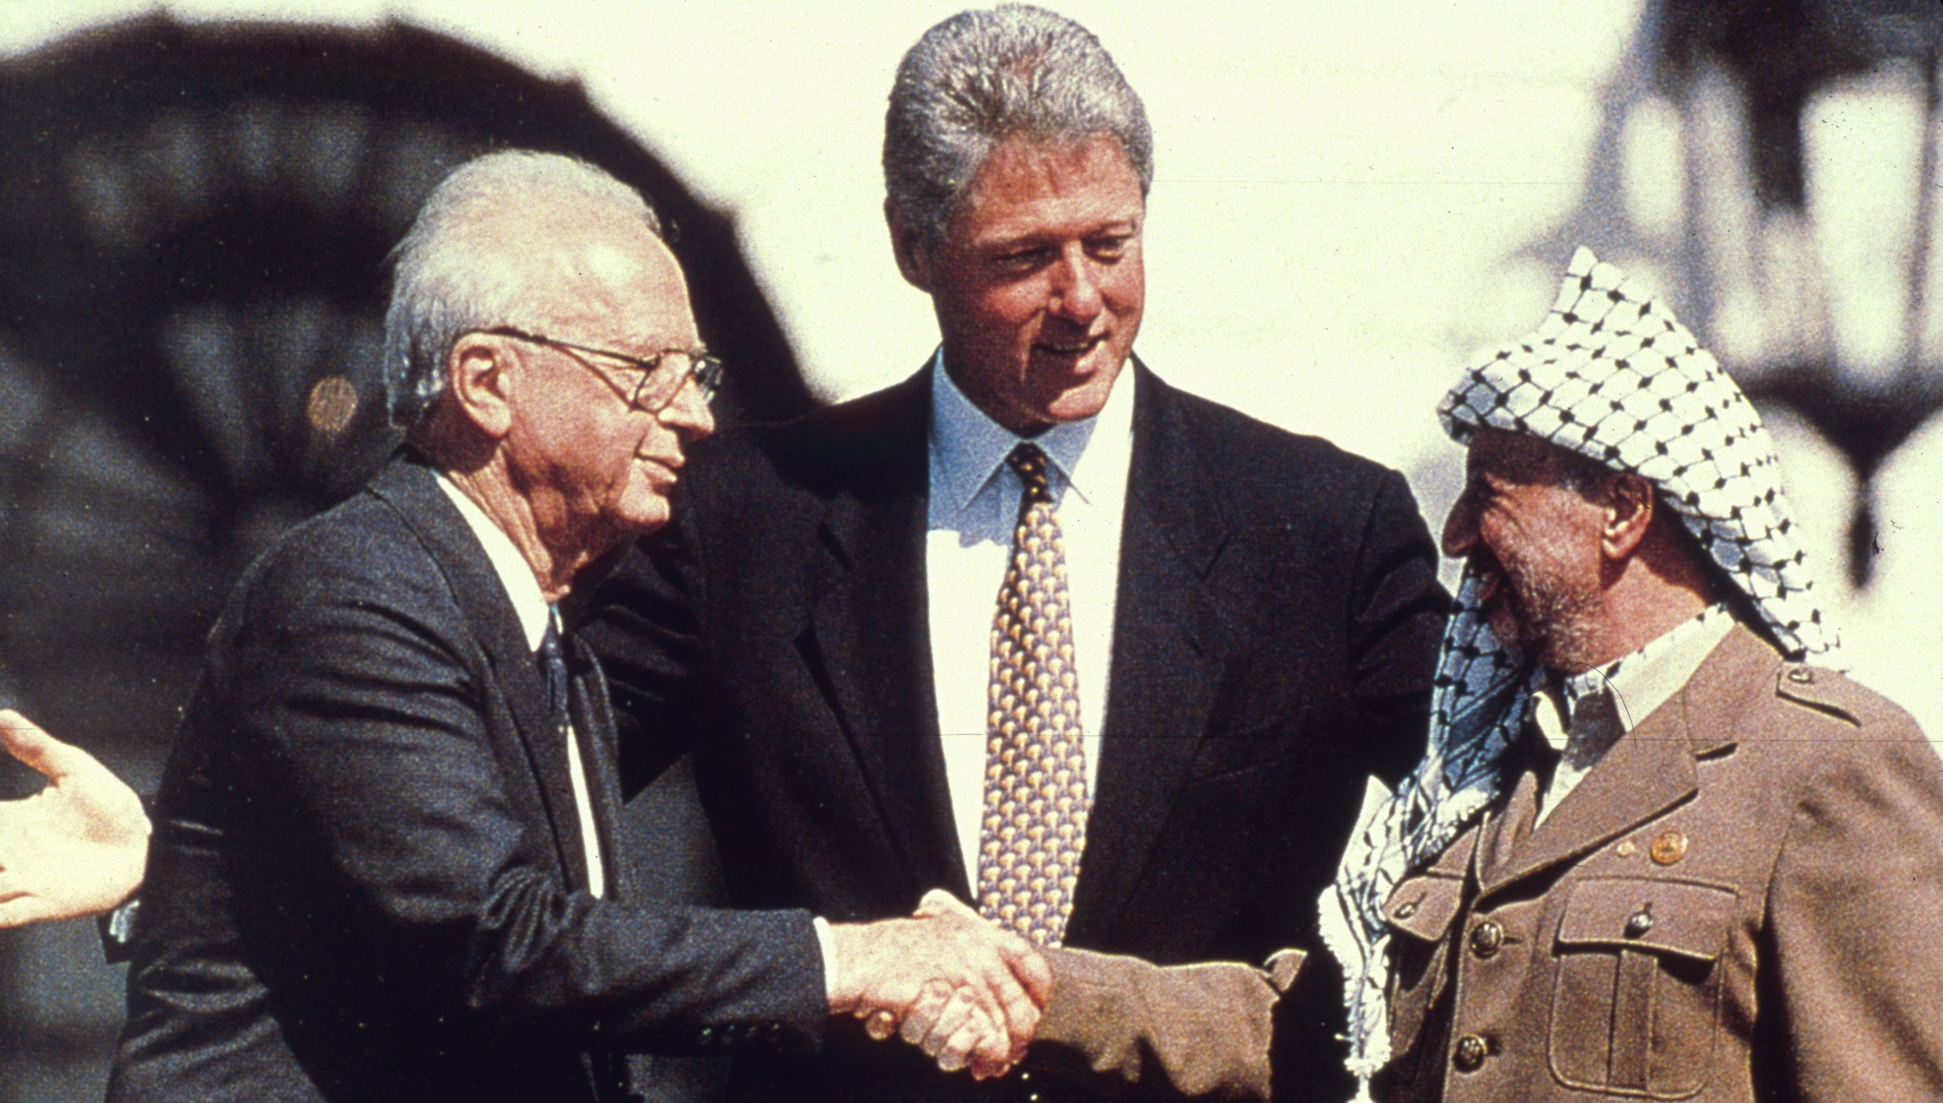
How successful were the Oslo Accords?
Lesson 12

Slide 2
Learning objectives
By the end of this lesson, you should be able to:
Describe what the Oslo Accords were
Explain why the Oslo Accords were celebrated
Discuss the success of the Oslo Accords

Slide 3
Today’s keywords In small groups: have you come across any of these before?
Add these to your glossary
Oslo Accords
Peace process
Johan Jorgen Holst
Yitzhak Rabin

Slide 4
Today’s keywords In small groups: have you come across any of these before?
Add these to your glossary
Oslo Accords: agreements between Israel and the PLO in 1993 and 1995. They agreed to work together for 5 years to reach an agreement about the future of Palestine and Israel
Peace process: a series of steps that lead towards peace
Johan Jorgen Holst: the Norwegian Foreign Minister who started the secret negotiations (in Oslo) that led to the Oslo Accords
Yitzhak Rabin: Prime Minister of Israel between 1974 and 1977 and from 1992 until his assassination in 1995

Slide 5
Recap – in pairs:
What was the First Intifada?
2) What was life like for Palestinians between 1967 and 1987? What caused the First Intifada?
A massive uprising of Palestinians against Israel’s ongoing occupation of the West Bank and Gaza. It took place between 1987 and 1993
Life was very difficult for Palestinians. More and more Palestinians lost their homes and tensions increased.
On 8th December 1987, four Palestinians were killed in a collision with an IDF truck in Jabalia refugee camp, Gaza.
For the Palestinians, this was the final straw: the First Intifada now began

Slide 6
Watch up to 1:56 for an introduction to the Oslo Accords
https://www.youtube.com/watch?v=ism-ctaSbw0

Slide 7
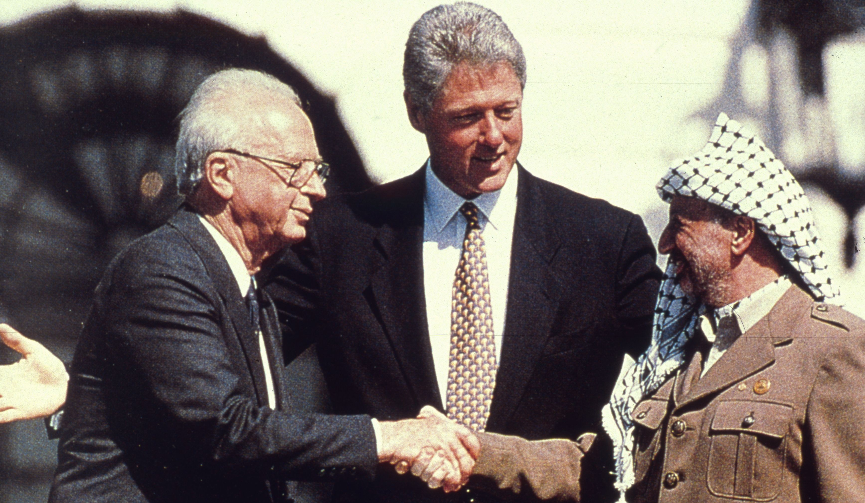
The Oslo Accords
Agreements between the Israeli government and the PLO (Palestine Liberation Organization) in 1993 and 1995
Israel and the PLO agreed to work together for 5 years to reach an agreement about the future of Palestine and Israel

Slide 8
12a. The Oslo Accords: the details (I)
Israel and the PLO agreed to work together for 5 years to reach an agreement about the future of Palestine and Israel
First, both sides recognized the legitimacy of the other
In 1988, the PLO recognized Israel as a country
In 1993, Israel recognized the PLO as representative of the Palestinian people
On 13th Sep 1993 in Washington DC, Oslo I was signed: The Declaration of Principles on Interim Self-Government Arrangements
Agreed that an elected Palestinian parliament would be established
Agreed that Israel would gradually withdraw from some parts of Gaza
Agreed that the PLO would distance itself from terrorist groups
→ we are going to look at the letters of ‘mutual recognition’ next

Slide 9
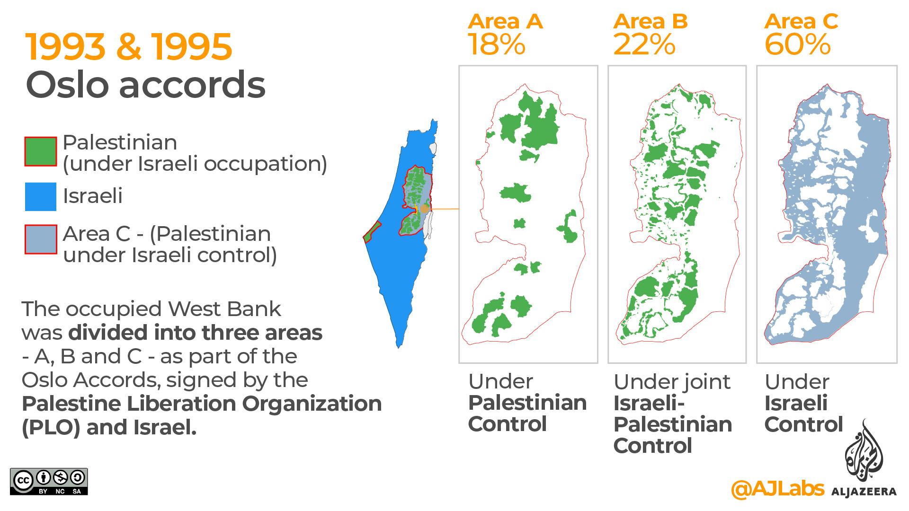
12a. The Oslo Accords: the details (II)
Two years later, on 28th Sep 1995 in Taba, Egypt, Oslo II was signed:
Agreed that Gaza would be part of Palestine
The West Bank would be split into three areas: A, B and C
Stick this information into your book

Slide 10
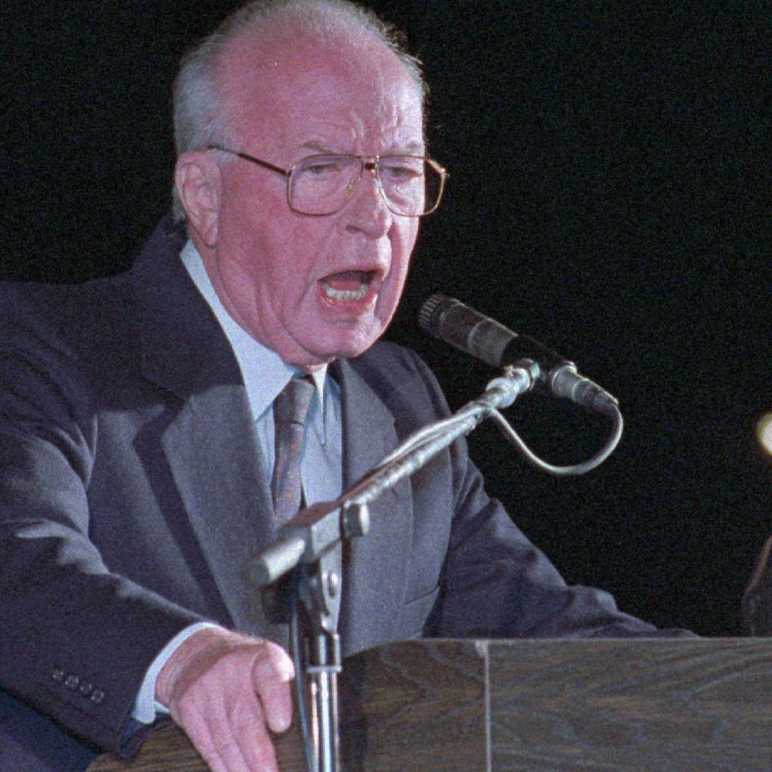
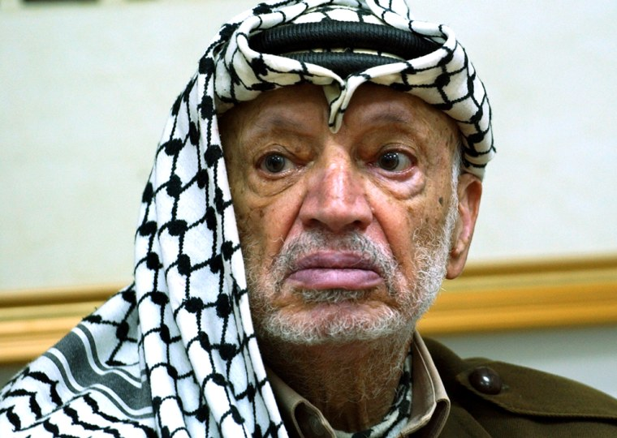
12b. Letters of ‘mutual recognition’
Yitzhak Rabin (Prime Minister of Israel)
Letter A
September 9, 1993
Mr. Prime Minister (Yitzhak Rabin),
The signing of the Declaration of Principles marks a new era... I would like to confirm the following PLO commitments: The PLO recognizes the right of the State of Israel to exist in peace and security… The PLO commits itself...to a peaceful resolution of the conflict between the two sides… the PLO renounces the use of terrorism and other acts of violence…
Sincerely,
Yasser Arafat (Chairman of The Palestine Liberation Organization)
In small groups, read through the letters and highlight the most significant parts
Why are these parts significant?
Letter B
September 9, 1993
Mr. Chairman (Yasser Arafat),
In response to your letter of September 9, 1993, I wish to confirm to you that, in light of the PLO commitments included in your letter, the Government of Israel has decided to recognize the PLO as the representative of the Palestinian people and commence negotiations with the PLO within the Middle East peace process…
Yitzhak Rabin (Prime Minister of Israel)
Yasser Arafat (Chairman of the PLO)

Slide 11
12b. Letters of ‘mutual recognition’
Yitzhak Rabin (Prime Minister of Israel)
Letter A
September 9, 1993
Mr. Prime Minister (Yitzhak Rabin),
The signing of the Declaration of Principles marks a new era... I would like to confirm the following PLO commitments: The PLO recognizes the right of the State of Israel to exist in peace and security… The PLO commits itself...to a peaceful resolution of the conflict between the two sides… the PLO renounces the use of terrorism and other acts of violence…
Sincerely,
Yasser Arafat (Chairman of The Palestine Liberation Organization)
In small groups, read through the letters and highlight the most significant parts
Why are these parts significant?
Letter B
September 9, 1993
Mr. Chairman (Yasser Arafat),
In response to your letter of September 9, 1993, I wish to confirm to you that, in light of the PLO commitments included in your letter, the Government of Israel has decided to recognize the PLO as the representative of the Palestinian people and commence negotiations with the PLO within the Middle East peace process…
Yitzhak Rabin (Prime Minister of Israel)
Yasser Arafat (Chairman of the PLO)

Slide 12
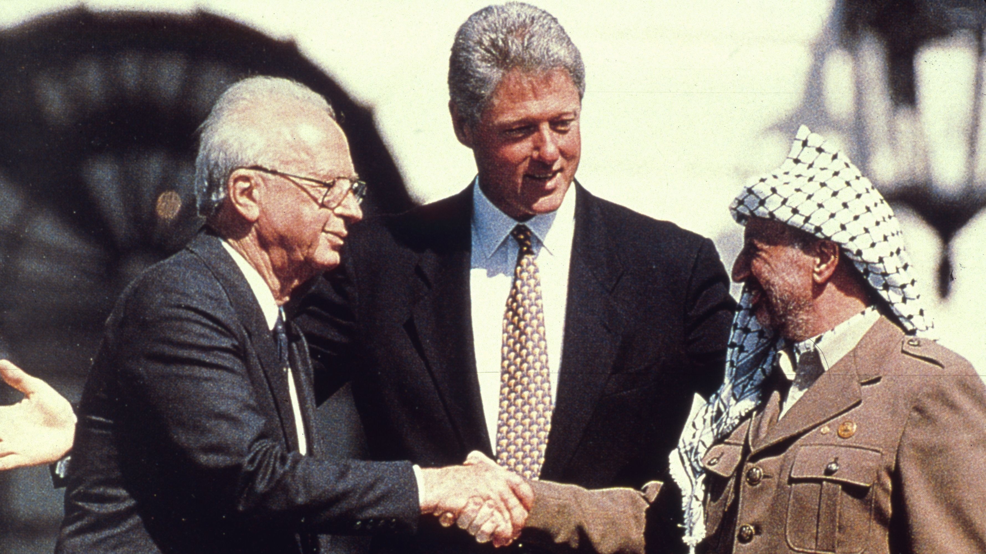
Oslo Accord I: The Declaration of Principles on Interim Self-Government Arrangements
“The Government of the State of Israel and the PLO team (in the Jordanian Palestinian delegation to the Middle East Peace Conference) (the "Palestinian Delegation"), representing the Palestinian people, agree that it is time to put an end to decades of confrontation and conflict, recognize their mutual legitimate and political rights, and strive to live in peaceful coexistence and mutual dignity and security and achieve a just, lasting and comprehensive peace settlement and historic reconciliation through the agreed political process”
Washington DC, 13th Sep 1993
With the person next to you, can you summarise this agreement in one sentence?

Slide 13
In small groups, discuss these questions:
Why were the letters of ‘mutual recognition’ important? Have we seen anything similar before?
What is a ‘peace process’? Why were the Oslo Accords seen as the start of a peace process?
No! This was the first time that Israel had recognised the PLO as representative of the Palestinian people, and it was only recently that the PLO had recognised Israel’s right to exist. This was a necessary step towards finding a solution to the problem!
A ‘peace process’ is a series of steps that lead towards peace. The Oslo Accords were seen as the start of a peace process because both Israel and the PLO appeared committed to finding a solution to the problem and achieving peace. They agreed to work together for five years to decide on the future of Palestine and Israel
Working independently now, answer this question in your book:
Why were the Oslo Accords celebrated?
Extension question: can you identify any problems with the Oslo Accords at this point?

Slide 14
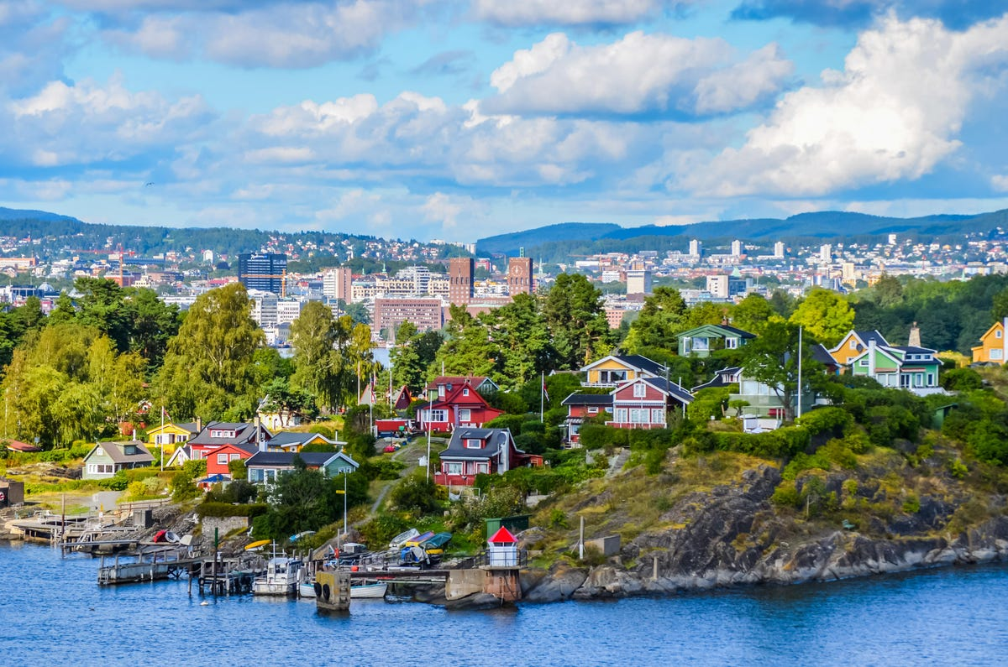
Why the ‘Oslo’ Accords?
https://www.youtube.com/watch?v=Jj47n0C3G5g
Because Oslo in Norway is where the secret negotiations that led to the Oslo Accords began
The negotiations were started by Johan Jorgen Holst, the Norwegian Foreign Minister
There is a stage play called ‘Oslo’ about this. Watch this clip

Slide 15
What happened?
At first, things went according to plan:
Israel withdrew troops from Gaza and Jericho
Under the 1994 Gaza-Jericho Agreement, an elected Palestinian parliament was established: the Palestinian Authority (PA)
However:
Israeli settlements continued to be constructed in the West Bank
Israel felt that the PA was not distancing itself adequately from terrorist groups
Discuss the following with the person next to you:
How would you feel about these developments if you were:
a. Palestinian?
b. Israeli?
What is the problem here?

Slide 16
So was a peace agreement reached?
Neither side felt that the other was keeping its end of the deal
So the goodwill that was so crucial to reach an agreement between Israel and Palestine deteriorated
No peace agreement was reached
And then the Camp David Summit failed in 2000, paving the way for the Second Intifada (we’ll look at this next lesson)

Slide 17
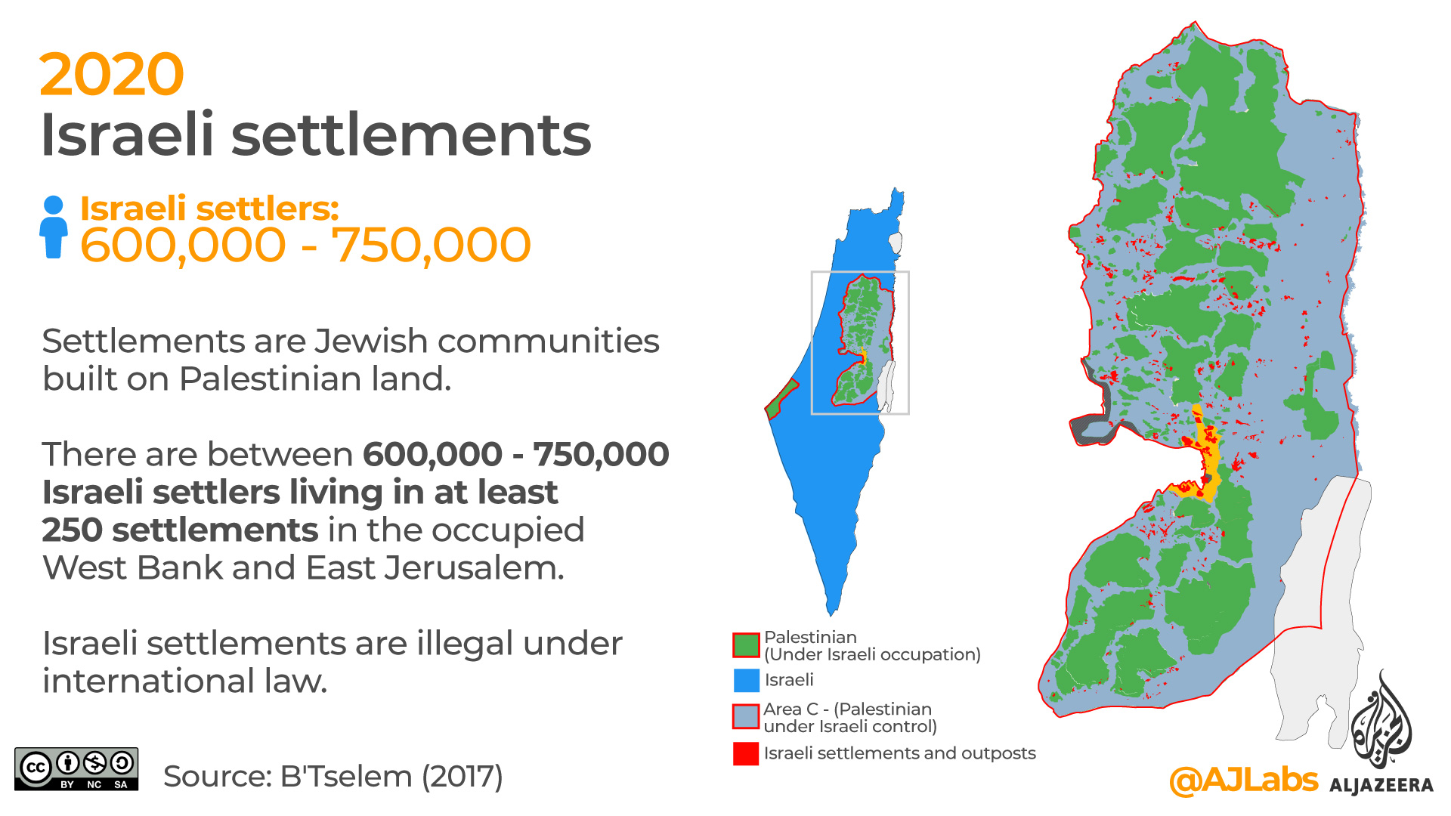
What happened to the Palestinian land that had been divided into areas A, B and C under the Oslo Accords?
This "temporary” division of Palestinian territory remains in place today!
What does this map show?

Slide 18
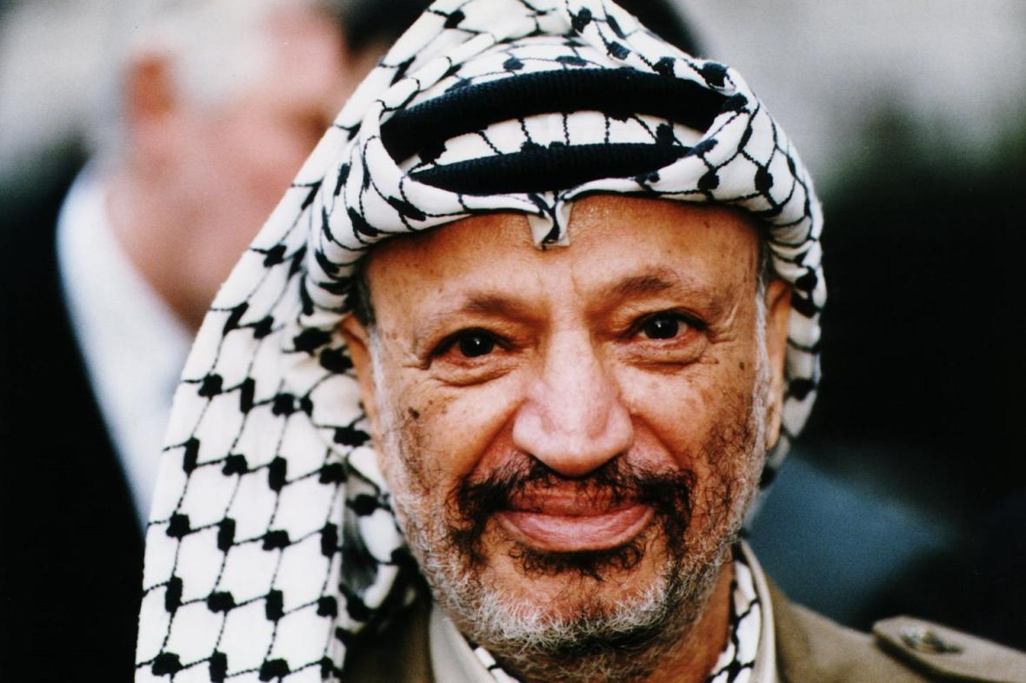

Slide 19
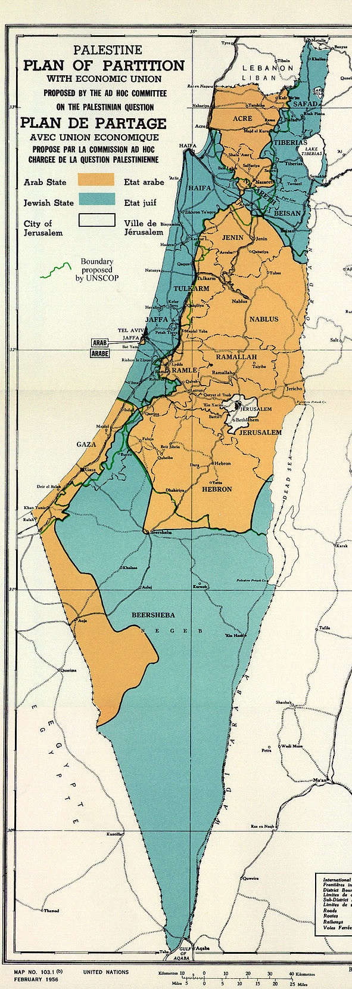
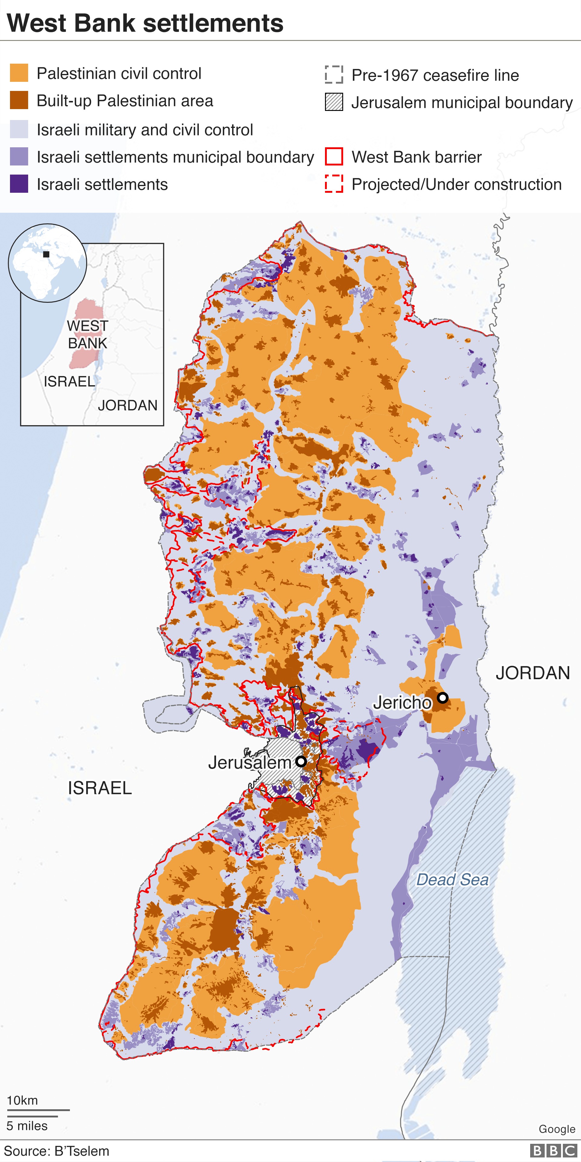
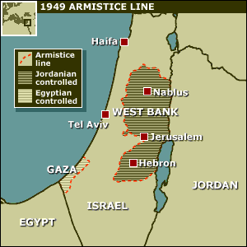
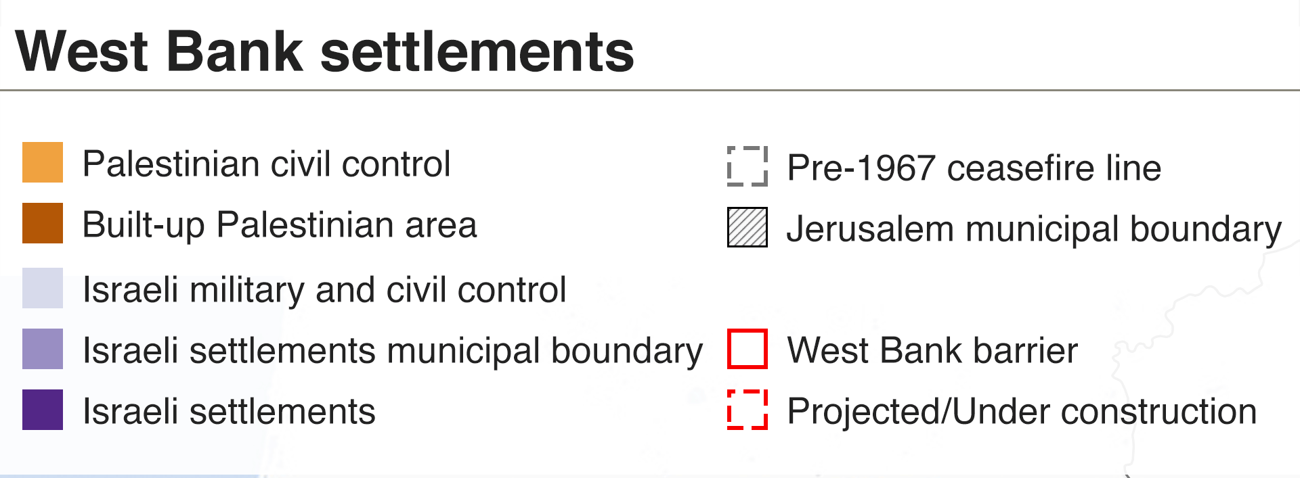
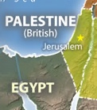
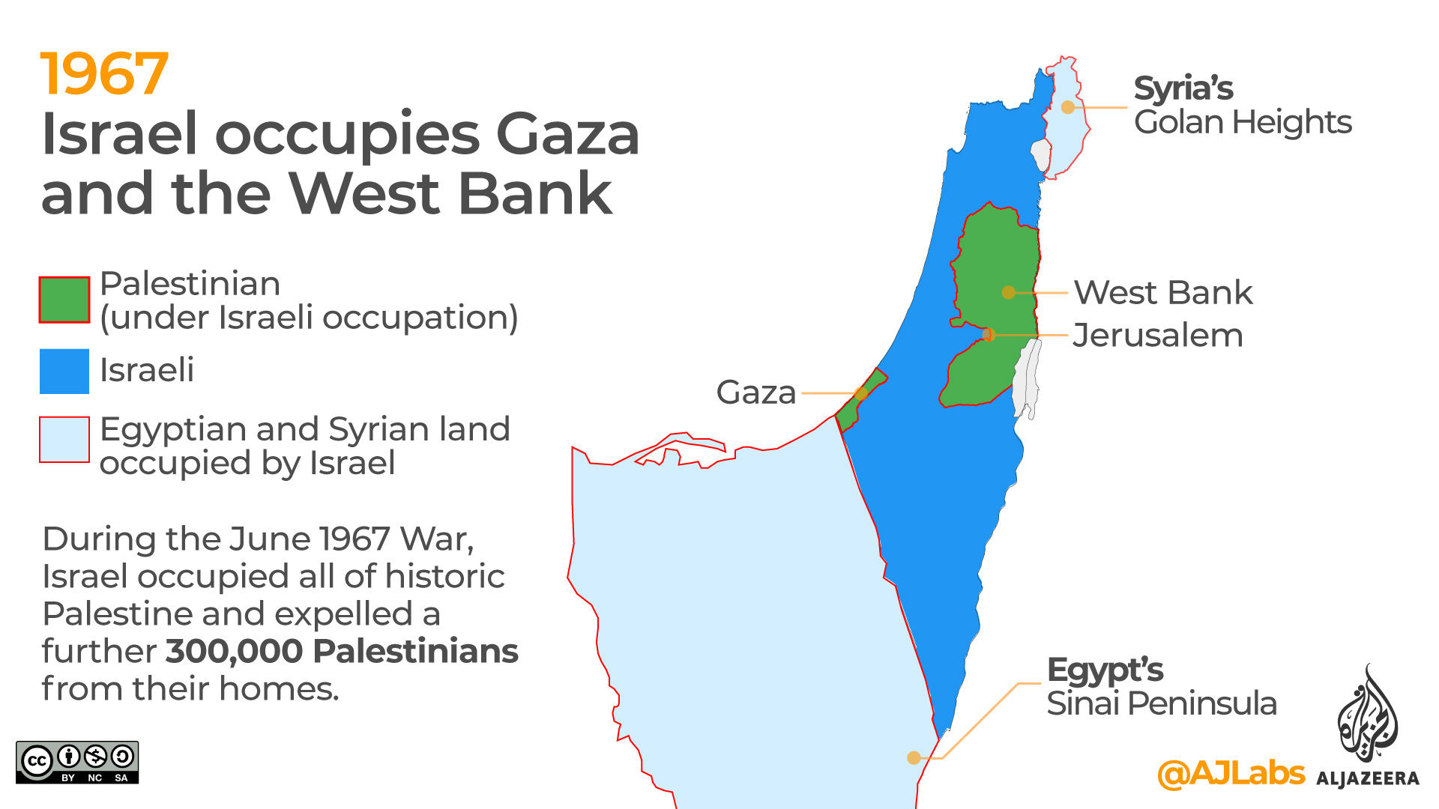
12d. In small groups, use these maps to discuss how Palestinians would have felt in the 1990s

Slide 20
Homework
What can you remember about the Treaty of Versailles?
The Oslo Accords have been described by Edward Said as a Palestinian Versailles - “let us call the agreement by its real name: an instrument of Palestinian surrender, a Palestinian Versailles”
To what extent were the Oslo Accords a Palestinian Versailles?
Remember to justify and contextualise your answer.
Full article by Said: https://www.lrb.co.uk/the-paper/v15/n20/edward-said/the-morning-after
The Treaty of Versailles was signed at the Palace of Versailles outside Paris (pictured)

Slide 21
Plenary: exit slips
With a partner, name two things you have learnt today about the Oslo Accords

